Slide 1
Promoting Green Chemistry and Sustainability in Chemistry Courses
AFACCT Conference
January 8, 2015
Maureen Sherer, Anne Arundel Community College

Slide 2
Why Green Chemistry?
Building a healthier future.
Supporting recommendations of American Chemical Society (ACS) as a component of undergraduate curriculum.
Meeting industry & international guidelines.

Slide 3
12 Principles of Green Chemistry
1. Prevent waste
2. Atom Economy
3. Less Hazardous Synthesis
4. Design Benign Chemicals
5. Benign Solvents & Auxiliaries
6. Design for Energy Efficiency
7. Use of Renewable Feedstocks
8. Reduce Derivatives
9. Catalysis (vs. Stoichiometric)
10. Design for Degradation
11. Real-Time Analysis for Pollution Prevention
12. Inherently Benign Chemistry for Accident Prevention
www.acs.org/greenchemistry

Slide 4
How?
Introduce new experiments with a “Greener Footprint”.
Re-evaluate existing experiments according to Green Chemistry Principles.
Case Studies for Students to Analyze.

Slide 5
Green Synthesis of Divanillin
Adapted from Nishimura, R.T.; Giammanco, C.H.; Vosburg, D.A., J. Chem. Educ. 2010, 87, 526-527.

Slide 6
Divanillin
Students practice important synthetic chemistry techniques.
No hazardous exposures.
Minimal waste.
Good results.
Readily adaptable to sophomore organic or to freshman bio-chemistry.

Slide 7
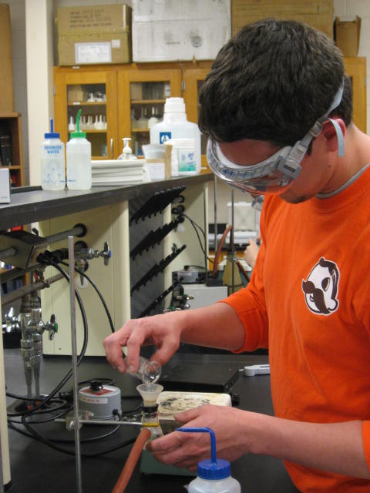
Divanillin – Student Working in Lab

Slide 8
Potassium Ion Concentration Determined by Atomic Absorption Spectroscopy (AAS)
State-of-the-art instrumental method.
No hazardous waste.
AACC AAS is a Perkin Elmer AAnalyst 200.

Slide 9
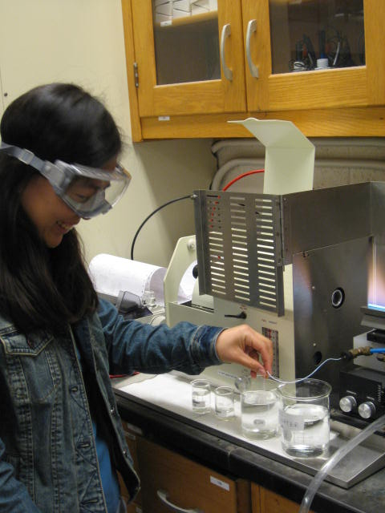
[K⁺] by AAS – Student Working in Lab

Slide 10
Re-evaluating Existing Experiments
Cost-Benefit Analysis
For each experiment, consider:
Materials.
Energy Inputs.
Scale (Macro or Semi-Micro).
Water Required (Cooling, suction, clean-up).
Atom Economy.
Waste/Clean-up.
Skills and Concepts Taught.

Slide 11
New Technologies & Methodologies to Consider
Electric pump rather than water aspiration for suction filtration.
Microwave oven for heating.
Computer simulations and molecular modelling.
Metrics to evaluate “green-ness”, (e.g. Sean M. Mercer, et al, J Chem Ed, 2012, 89, 215-220).
Others…

Slide 12
Some Old Ways Are Important Too
Students still need to know proper protocols for the safe handling and ultimate disposal of materials.
This is part of the learning students need to acquire in general and organic chemistry courses. Students learn by doing.

Slide 13
Students Analyzing Case Studies & Investigating Green Chemistry Principles
Building critical thinking skills.
Promoting sustainable practices.
Opportunity for our daily lives.

Slide 14
Investigating Green Chemistry Principles Using a Worksheet
Students are given a worksheet which directs them to several websites about green chemistry, life cycle perspective, Safety Data Sheets (SDS), the Globally Harmonized System (GHS), and others.
Students have a set of questions to answer about what they learn from reading the websites.
This prepares them to analyze case studies.

Slide 15
Case Study Example
Ethylenediaminetetraacetate (EDTA)
vs. Iminodisuccinate (IDS)
EDTA degrades slowly in the environment, during this time it can leach heavy metals into the groundwater.
IDS is nontoxic & readily degrades in the environment so leaching problem is circumvented.

Slide 16
Case Study, continued
Students are given some information about EDTA & IDS to read.
Students then list and explain the relevant Green Chemistry Principles which support the use of IDS (in cases where they are interchangeable).
Please see handout for more details.

Slide 17
Other Case Studies Involve…
Use of Liquid CO₂ as a Nonpolar Solvent, rather than Diethyl Ether, etc.
Use of nitrate reductase in the quantitative determination of nitrate in the aquatic environment, rather than Cd/Cu.
Semi-micro scale experiments rather than macro scale.
Comparing two different syntheses for a given compound.

Slide 18
Green Chemistry Resources
ACS Green Chemistry Institute.
U.S. EPA - Risk Management, Green Chemistry and Engineering.
Green Chemistry at the University of Oregon.
The Berkeley Center for Green Chemistry.
Green Chemistry at the University of Toronto.
Beyond Benign.
ACS Webinars on Green Chemistry.
Please see handout for web addresses.

Slide 19
Discussion
Your Ideas…
Let’s stay in touch to share ideas and resources…
Maureen Sherer, masherer@aacc.edu

Slide 20
Acknowledgements
Debbie Reeder, AACC Chemistry Lab Manager.
The AACC Chemistry Lab Staff.

